Slide 1

UNIVERSITY COLLEGE OF ENGINEERING BHARATHIDASAN INSTITUTE OF TECHNOLOGY CAMPUS, ANNA UNIVERSITY, TRICHY- 620 024.
Crop Selection and Possible Diseases Prediction System Using Deep learning
MERLIN JONE J
810019205062
GUIDED BY:
Mr.K.SARAVANAKUMAR,
TEACHING FELLOW,
DEPARTMENT OF CSE/IT.
YAHAVARSHINI E
810019205110

Slide 2
AGENDA
Abstract
Introduction
Proposed system
Literature Survey
System Architecture
Data Flow Diagram
Modules & Algorithms
Results and Screenshots
References

Slide 3
ABSTRACT
India is an agricultural nation. A significant portion of India's economy is based on agriculture. In India, agriculture takes up as much as 60% of the total land area. This provides food for 1.2 billion people worldwide. The Indian farmer is at the centre of the agricultural industry, but the majority of Indian farmers continue to be at the very bottom of society. In addition, despite the limited technical options available today, farmers still struggle to choose the crop that is most profitable for their land due to the wide variety of soil types , unpredictable climatic conditions found throughout the world. In order to increase agricultural output, which also leads to economic growth, it will be very important to predict the correct crop at the right area at the right time and also predicting possible diseases for that crop, can alert the farmers to check and use the fertilizers periodically. This proposed model suggests a crop and possible diseases that makes use of Multi-Layer Perception (MLP) algorithm to analyse a variety of criteria, such as the temperature, soil nutrition, weather, rainfall in order to forecast the ideal crop to be cultivated and possible diseases that can affect that crop during cultivation period. Also, this technique would lessen the financial loss that farmers suffer as a result of planting the unsuitable crop.

Slide 4
INTRODUCTION :
Crop selection and disease prediction are critical aspects of agriculture. The right crop selection can ensure maximum yield, while early detection and prevention of diseases can save crops from damage and enhance production. These tasks require a comprehensive understanding of various factors, such as soil quality, climate conditions, and disease prevalence, which can affect crop growth and health. Traditionally, farmers rely on their experience and knowledge to make crop selection and disease prevention decisions. However, this approach can be time-consuming and prone to errors, leading to reduced crop yield and losses. With the advancements in technology and data analytics, it is now possible to develop automated systems that can assist farmers in these tasks. One popular approach to crop selection and disease prediction is the use of machine learning algorithms. Machine learning algorithms can analyze large datasets and extract insights to make accurate predictions. One popular machine learning algorithm used for these tasks is Multilayer Perceptron (MLP). To develop a crop selection and disease prediction system using MLP, historical data on crop yield, soil quality, climate conditions, and disease prevalence are used as input. The MLP algorithm analyzes the data to determine the optimal crop selection and predict the likelihood of disease outbreaks. The system provides farmers with timely alerts and recommendations to take preventive measures to protect their crops.

Slide 5
PROPOSED SYSTEM
The proposed system is aimed at developing a web-based application for crop selection and possible diseases prediction system using MLP algorithm.
GOAL
The main goal of the Crop selection and possible diseases prediction system web application is to provide a user-friendly and efficient platform for farmers and agriculture enthusiasts to identify the most suitable crop for a given set of environmental conditions and predict the possible diseases that might affect the crop.

Slide 6
Literature Survey :
SI . No | Journal Name & Year | Authors | Concepts/ Techniques | Advantages | Disadvantages
1. | Crop Recommendation System Using Machine Learning Algorithm. 2022 (IJCRT) | Mr.Omkar Kulkarni,Mr. Sushil Buragute, Mr.AshwinKhod,Mr.Melvin Fernando,Prof. Nilesh Korade | Machine learning Random Forest Algorithm | It has Robustness, It is Easy to interpret, It is Fast. | It is Simple model representation
2. | Crop Prediction using Machine Learning Approaches . 2020 (IJERT) | Nischitha K, DhanushVishwakarma, Mahendra N , Ashwini, Manjuraju M.R | Machine Learning, Decision tree, SVM | It shows Accurate predictions | Decision trees may not perform well. Sensitivity to feature selection
3. | Soil Analysis and Crop Recommendation using Machine Learning. 2021 (Turkish Journal) | AdityaMotwani,ParamPatil,VatsNagaria ,Shobhit Verma ,Sunil Ghane | Random Forest, Deep learning, Convolutional Neural Network | It is User friendly It is Simple and fast | Recommend crop only on basis of the soil type which can minimise yield production
4. | Smart Crop Prediction using IoT and Machine Learning – 2021(IJERT) | Archana Gupta, Dharmil Nagda. Pratiksha Nikhare, Atharva Sandbhor | IoT and Decision Tree, KNN and Support Vector Machine (SVM) | It has Scalability, It show Improved accuracy | It is Lack of transparency and Data quality

Slide 7
5. | Machine Learning based Recommender Systems for Crop Selection: A Systematic Literature Review | Younes Ommane et al.,2022 | Systematic Literature Review | The accuracy of the recommendations can be limited if there is not enough historical data available to train the machine learning algorithms
6. | Crop Suggesting System Using Unsupervised Machine Learning Algorithm | K.D.Yesugade et al., 2019 | K-means algorithms | Its only taken two case and its may be complex for many cases(crops)
7. | Survey on Machine Learning for Crop Prediction Using Soil Nutrients Data | R.Kesavamoorthy et al.,2021 | Support Vector Machine, Bagged Tree, Adaboost, Naive Bayes, and Artificial Neural Network. | Only intake of soil nutrients parameters, so data insufficitent to give high accuracy
8. | Machine Learning Based Crop Recommendation System | Dhruv Piyush Parikh et al.,2021 | Machine Learning, Random Forest Classifier, Tkinter | Crop is recommended but yield is not predicted sometimes it may be affect profit
9. | Machine Learning for Detection and Prediction of Crop Diseases and Pests: A Comprehensive Survey | João C. Ferreira et al., 2022 | Random Forests, ANN,SVM Classfier Algorithm | Survey not deeply discussed about many research papers
10. | Crop Recommendation System | Pradeepa Bandara et al., 2020 | Naïve Bayes, Support Vector Machine, K-Means Clustering and also Natural Language Processing (Sentiment Analysis) | Date is more accurate but lack of output accuracy compared to other models

Slide 8
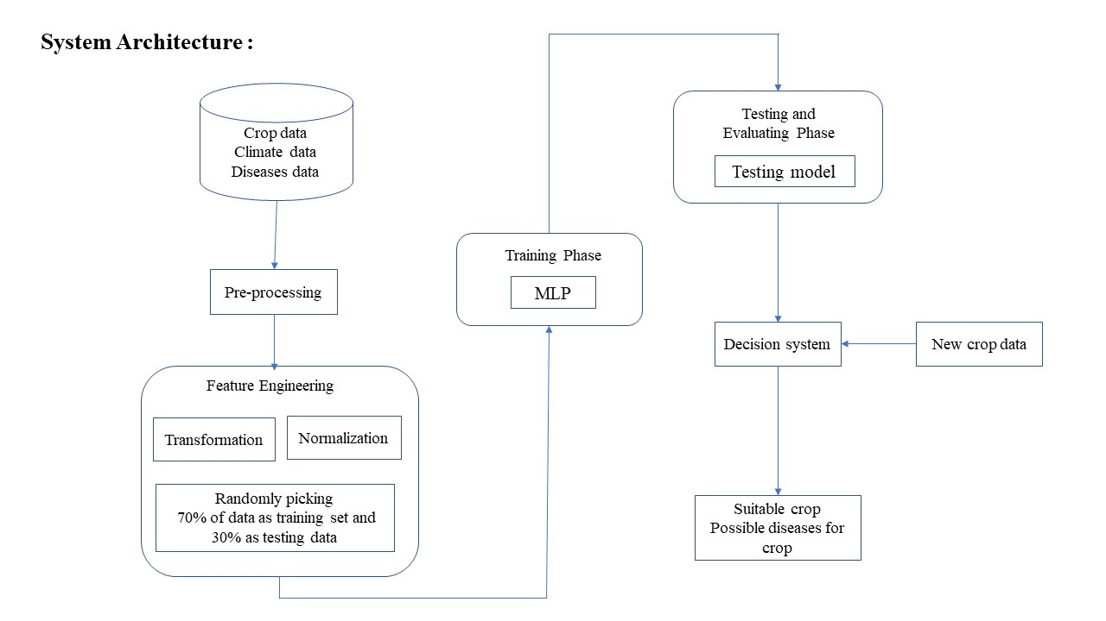

Slide 9
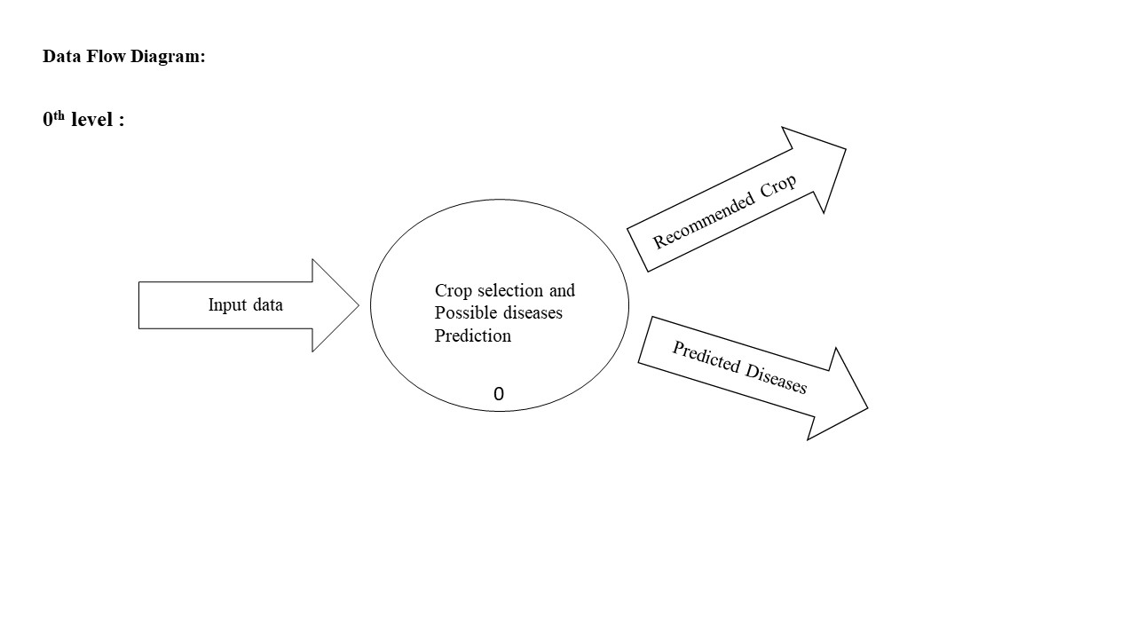

Slide 10
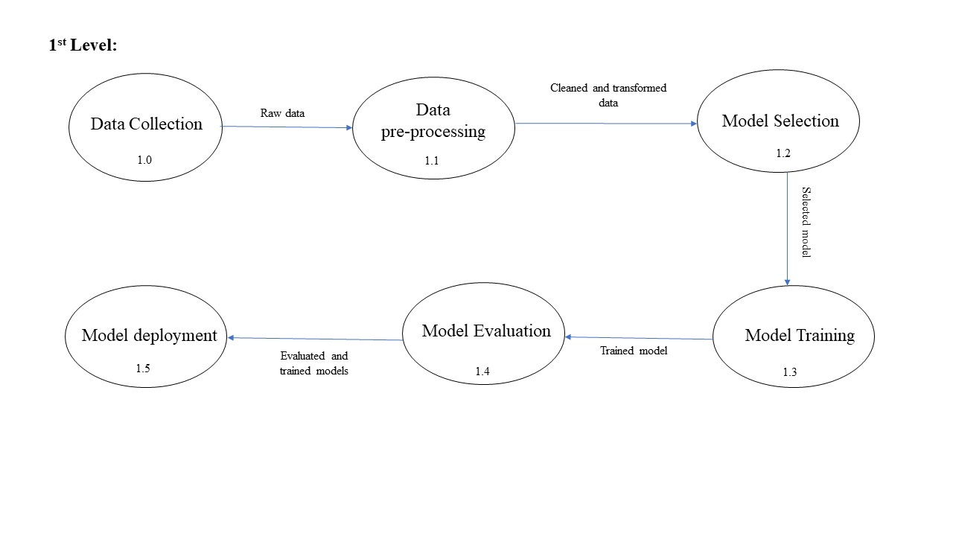


Slide 11
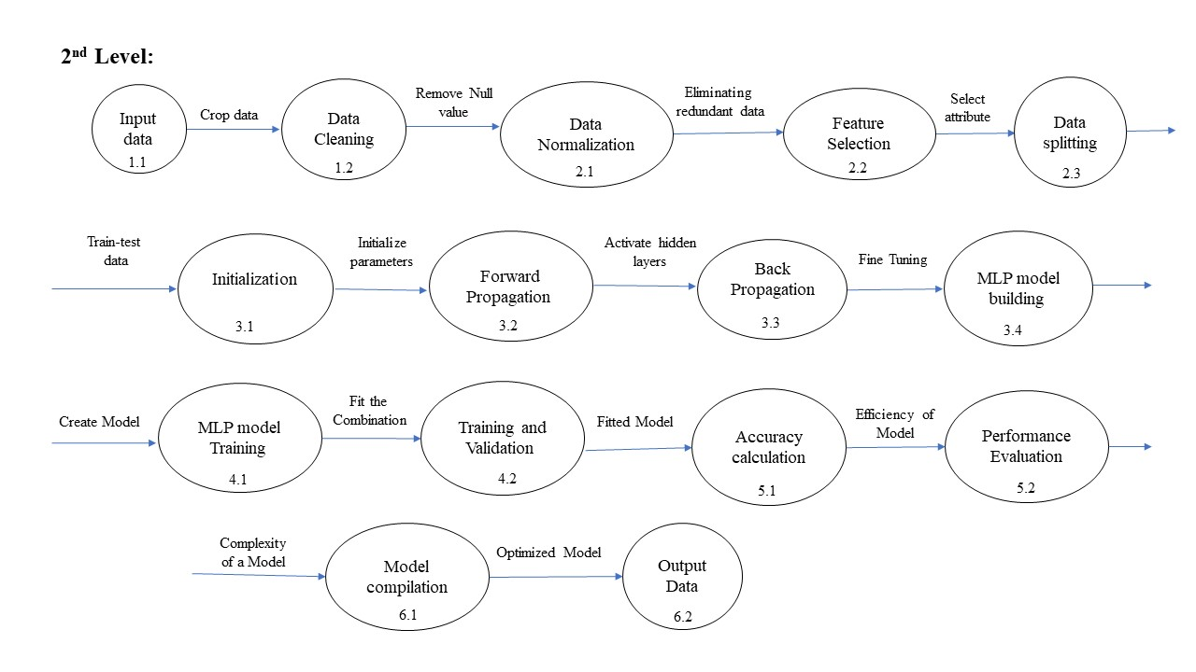

Slide 12
MODULES
Dataset collection and Pre-processing
Build the model
Train the model
Test the model and Accuracy
Front-end development

Slide 13
Algorithm [Module I – Completed] :
S1 : Collect date of soil nutrition ,rainfall, weather ,rainfall and crop diseases from agricultural resources.
S2 : Create a new dataset using pandas library.
S3 : Check the null values using df.isnull().sum()
S4: Normalize the data using mean , median , mode method to replace a null value.
S5: Plot the data using correction matrix and Scatterplot for data visualization
Algorithm [Module II – Completed] :
S1: Extract the input features as x and output features as Y fit to multiple output values using MultiLabelBinarizer..
S2: Split the datasets into training and testing sets.
S3: Create the MLP Classifier model using the MLPClassifier class from Scikit-learn library.
S4: Two hidden layers is created with neurons of each [Hidden_layer_sizes=(100,50,10)]

Slide 14
Algorithm [Module III - Completed]
S1: Backpropagation techniques is used to train the datasets into MLP Classifier model.
S2: The weights of connections are adjusted in each iteration until the error is minimized(max_iter=1000)
S3: fit() method is used to Fit the MLP model on the training data.
Algorithm [Module IV - Completed]
S1: Predict the output targets for the test data using Predict() method.
S2: The accuracy of the MLP classifier model is calculated using accuracy_score method from Scikit-learn library.
S3: The accuracy score is calculated by comparing the predict output targets with actual output targets in the testing sets.
Algorithm [Module V - completed]
S1 : Create a simple form using HTML,CSS,JS to get input parameters from users.
S2: MLP classifier model and the Webpage is integrated using Flask framework.
S3: Predicted output is displayed in output page.

Slide 15
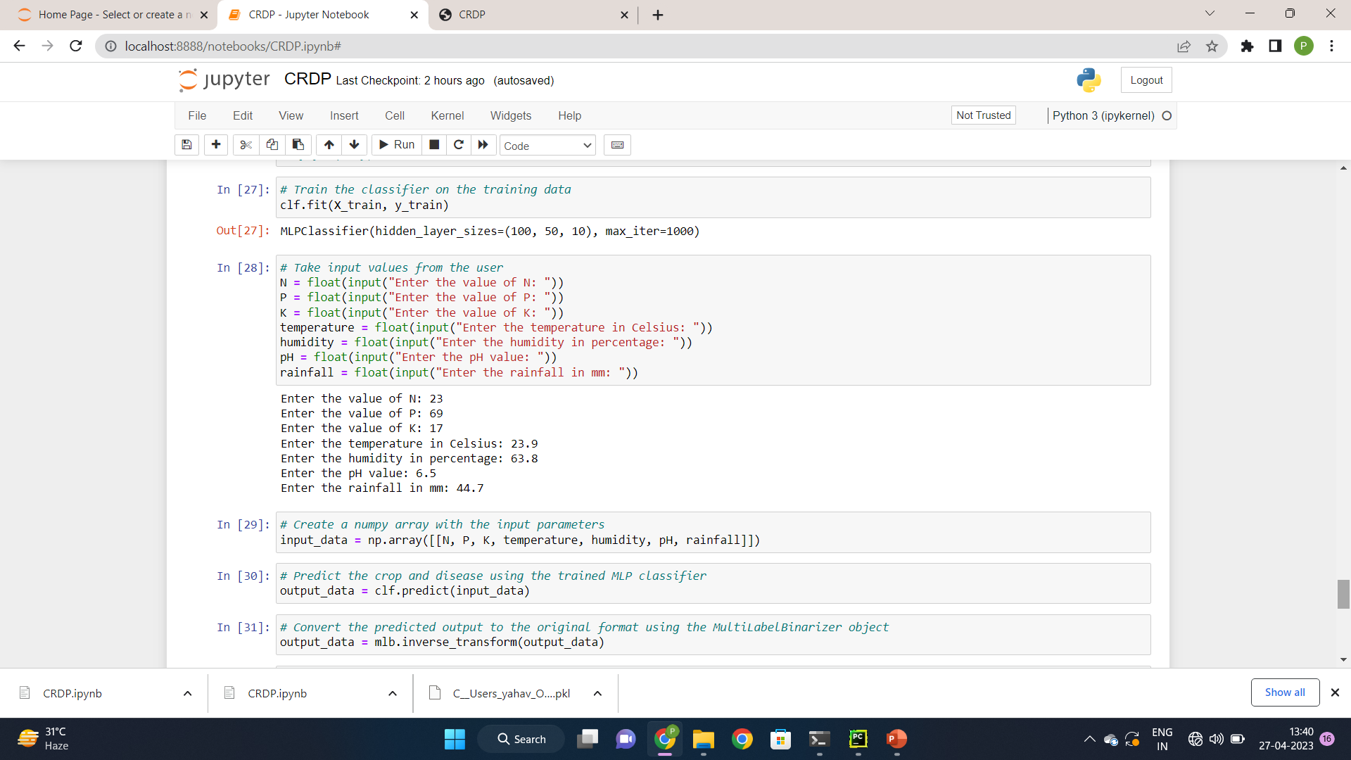
Results And Screenshots :
Backend

Slide 16
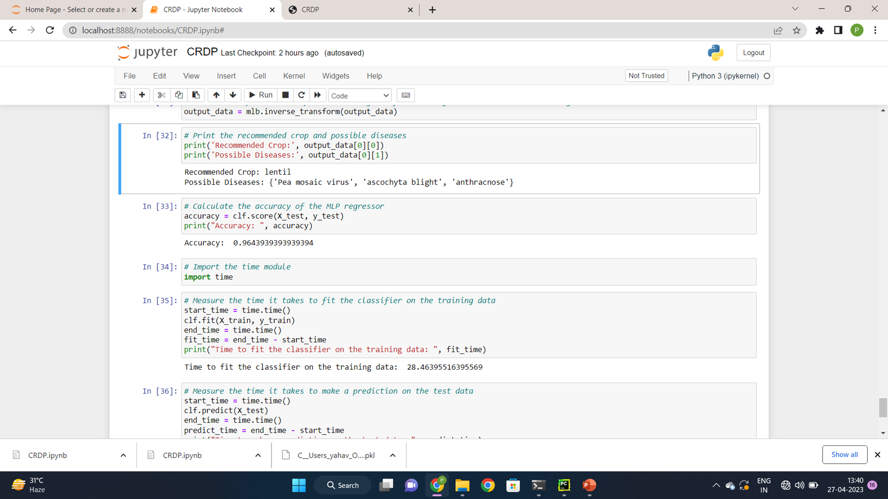

Slide 17
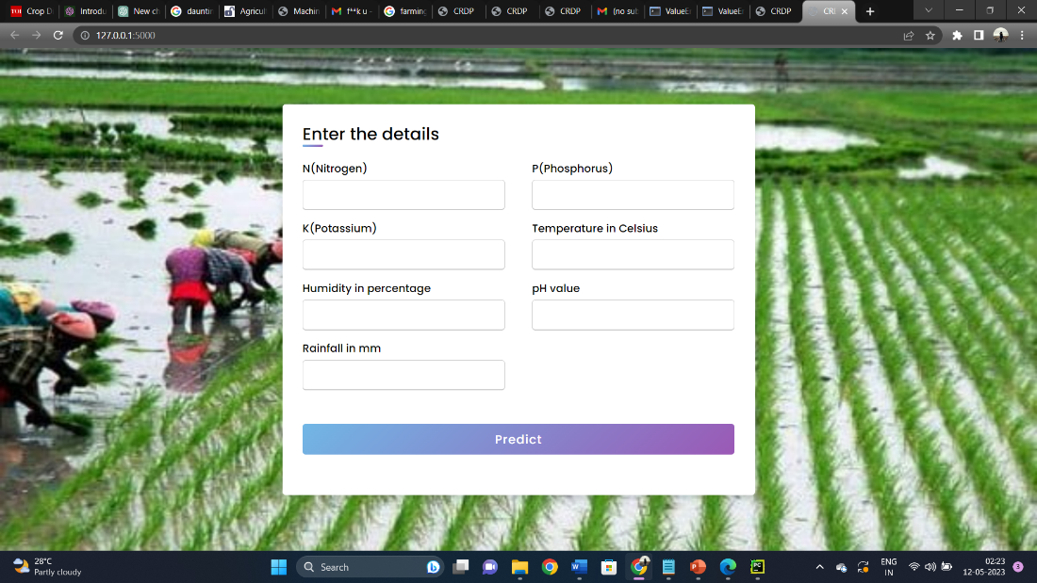
Frontend :

Slide 18
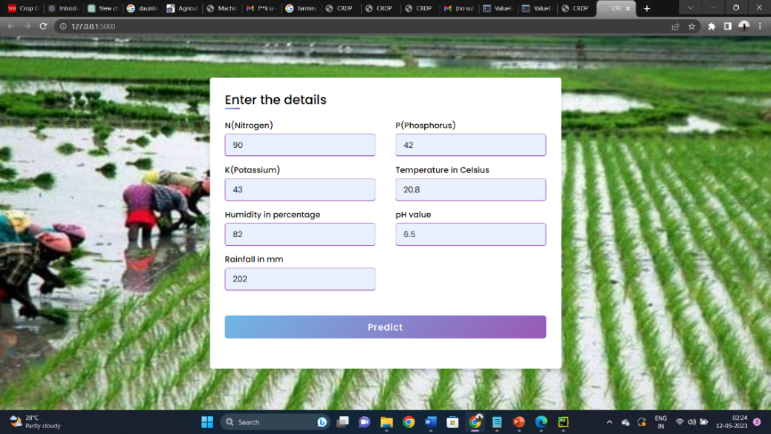

Slide 19
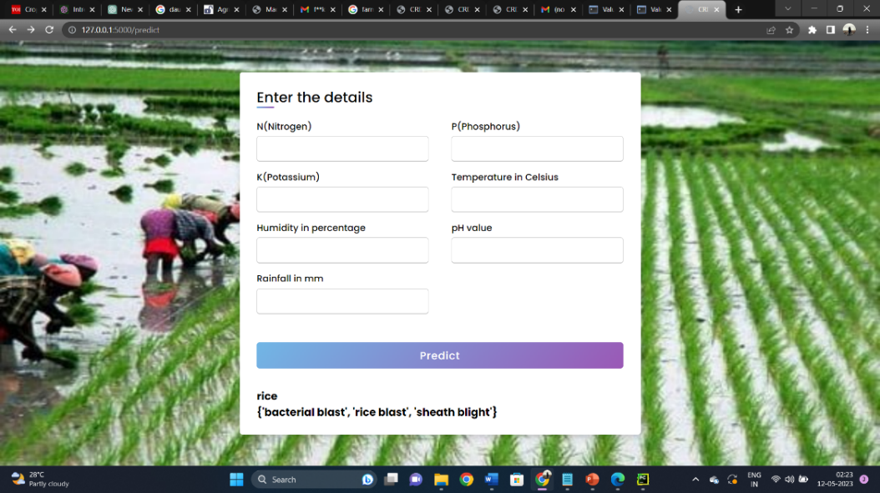

Slide 20
REFERENCES :
[1] Omkar Kulkarni, Sushil Buragute, Ashwin Khode, Melvin Fernando, Nilesh Korade, CROP RECOMMENDATION SYSTEM USING MACHINE LEARNING ALGORITHM , International Journal of Creative Research Thoughts (IJCRT), Volume 10, Issue 5 May 2022.
[2] Mahendra N , Dhanush Vishwakarma , Nischitha K , Ashwini, Manjuraju M. R, 2020, Crop Prediction using Machine Learning Approaches, INTERNATIONAL JOURNAL OF ENGINEERING RESEARCH & TECHNOLOGY (IJERT) Volume 09, Issue 08 (August 2020).
[3] Motwani, Aditya, Param Patil, Vatsa Nagaria, Shobhit Verma, and Sunil Ghane. "Soil Analysis and Crop Recommendation using Machine Learning." In 2022 International Conference for Advancement in Technology (ICONAT), pp. 1-7. IEEE, 2022.
[4] Archana Gupta,Dharmil Nagda,Pratiksha Nikhare,Atharva Sandbhor, ”Smart Crop Prediction using IoT and Machine Learning.” International Journal of Engineering Research & Technology (IJERT)-2021
[5] OMMANE, Y., RHANBOURI, M. A., CHOUIKH, H., JBENE, M., CHAIRI, I., LACHGAR, M., & BENJELLOUN, S. (2022). Machine Learning based Recommender Systems for Crop Selection: A Systematic Literature Review.

Slide 21
[6] K.D.Yesugade, Hetanshi,Chudasam,Aditi, Kharde, Ketki Mirashi Kajal Muley. Crop Suggesting System Using Unsupervised Machine Learning Algorithm.Research Gate. Vol.-7, Issue-3, March 2019
[7] Sundari V, Anusree M, Swetha U and Divya Lakshmi R, Crop recommendation and yield prediction using machine learning algorithms, World Journal of Advanced Research and Reviews, 2022, 14(03), 452–459.
[8] Parikh, Dhruv & Jain, Jugal & Gupta, Tanishq & Dabhade, Rishit. (2021). Machine Learning Based Crop Recommendation System. International Journal of Advanced Research in Science, Communication and Technology. 891-897. 10.48175/IJARSCT-1509.
[9] Tiago Domingues, Tomás Brandão & João C. Ferreira, Machine Learning for Detection and Prediction of Crop Diseases and Pests: A Comprehensive Survey, MDPI Volume: 09 Issue: 01 | Sept 2022.
[10] Bandara, Pradeepa & Weerasooriya, Thilini & T.H., Ruchirawya & Nanayakkara, W.J.M. & M.A.C, Dimantha & M.G.P, Pabasara. (2020). Crop Recommendation System. International Journal of Computer Applications. 175. 22-25. 10.5120/ijca2020920723.

